Slide 1
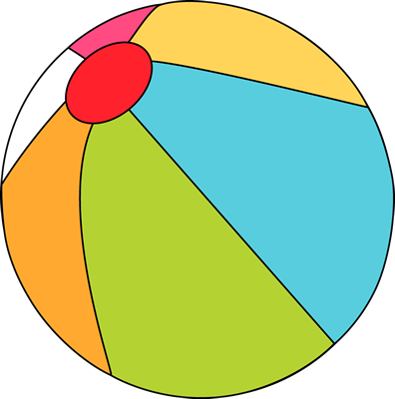













Sunday | Monday | Tuesday | Wednesday | Thursday | Friday | Saturday
 |  |  |  | 1 | 2 | 3
4 | 5 | 6 | 7 | 8 | 9 | 10
11 | 12 | 13 | 14 | 15 | 16 | 17
18 | 19 | 20 | 21 | 22 | 23 | 24
25 | 26 | 27 | 28 | 29 | 30 | 31
BridgePrep Academy of Riverview
Our Mission Statement
BridgePrep Academy believes every child learns best in a safe, nurturing and stimulating environment where high academic expectations, self-esteem, good character and an appreciation for the arts are promoted. BridgePrep Academy’s mission is to provide a challenging academic curriculum that will encompass an enriched Spanish language program, technology and experiences that will enable students to develop in all areas.
BridgePrep Academy’s goal is to educate well rounded individuals and enable students
to reach their maximum potential.
www.BridgePrepRiverview.com
https://www.facebook.com/BridgeprepAcademyRiverview/
Make sure to check the school website for all
upcoming events and updates
www.BridgePrepRiverview.com
Elementary
2-3pm & 6-7pm
Middle School
2-3pm & 6-7pm
School Hours-Early Dismissal
Kinder-2nd Grade
7:45am-1:30pm
3rd-5th Grade
7:45am-2:00pm
Middle School
8:30am-2:47pm
Early Release Day
Middle School Lead Day
NO UNIFORM $2
School Hours-Normal Dismissal
Kinder-2nd Grade
7:45am-2:30pm
3rd-5th Grade
7:45am-3:00pm
Middle School
8:30am-3:47pm
Early Release Day
Middle School Lead Day
School T-shirt Day
with uniform bottom
NO UNIFORM $2
Early Release Day
Middle School Lead Day
Fall Pictures
Wear navy blue or white polo
BridgePrep Academy
of Riverview
6309 S US Highway 301
Riverview, FL 33578
(813)405-1770
Palmetto Cookie Dough Fundraiser Kick-Off
School T-shirt Day
with uniform bottom
NO UNIFORM $2

